Slide 1
Communication Programme MS20
with Referenced & networked disaster risk management actors
Johanna Varghese
Meadhbh Costello
Karl Coleman
CARR Communications
07.04.2018

Slide 2
Contents
1
USP
IN-PREP Brand Core
Communication objectives
What are we communicating?
Why are we doing it?
Who are we targeting?
Timing and challenges
Action required from target audience
Message Product Channels
Referenced and networked method
Links to critical path and dissemination plan
2
3
4
5
6
7
8

Slide 3
IN-PREP USP*
Collaborative Response Planning
Multiagency
Training
Dynamic
Scenario
Building
End to end
Interoperable
system
for
preparedness
+ response
* Unique selling point

Slide 4
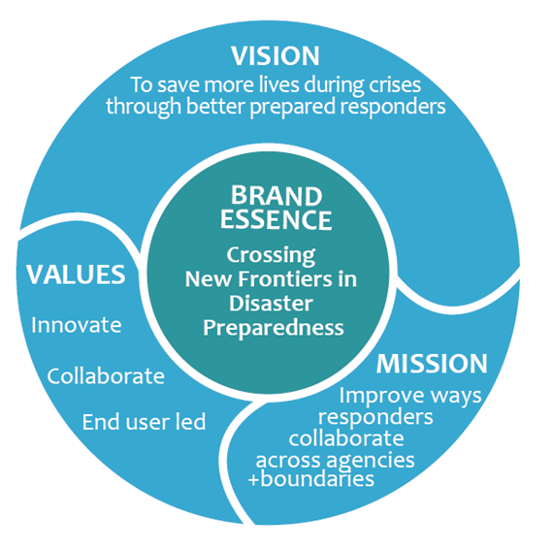
Brand + message
All our activities lead to the overarching vision of better prepared responders
Messages based on IN-PREP system offering civil protection + first responder agencies to

Slide 5
Objectives What why how who

Slide 6
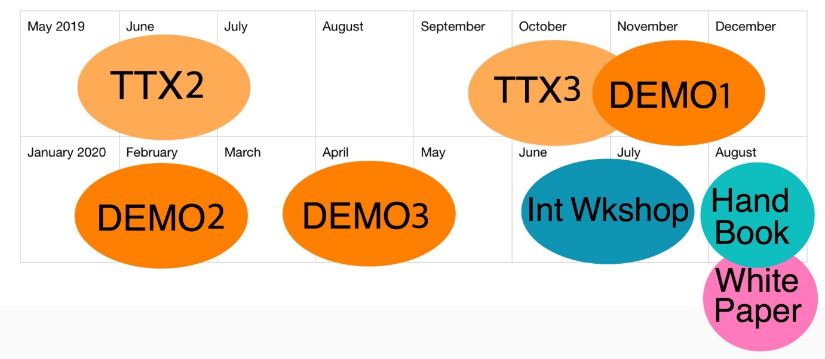
Timing * IN-PREP training programme + outreach events that partners attend
*link to communications programme critical path
https://redmine.iccs.gr/projects/in-prep/dmsf?folder_id=6738

Slide 7
Challenges

Slide 8
Action required from target audience
Promote + use IN-PREP training system for collaborative response planning
Participate in IN-PREP training programme
Validate + subscribe to the MRPP for multi agency training
Validate + use the Crisis Management Handbook

Slide 9
Message Products Channels
Deliverable 8.2 links breakthroughs with messages, audiences and channels for outreach events - p15
Deliverable 8.3 links key messages with sources of project results and audience - p16
Deliverable 8.4 links IN-PREP key events with messages - p25

Slide 10
Referenced and networked method
“… Utilise existing communication channels as communication amplifiers. These are well established networks, associations and groupings of disaster risk management actors … will be developed across the EU so that results of the IN-PREP training programme can be promoted with a high impact” IN-PREP DoA (p49/64)
1
Partners provided list of their networks; professional bodies or organisations
WP8 team slotted them into audience categories
Main messages and timing were matched to audience categories
2
3
Link to list of Referenced and Networked DRM actors

Slide 11
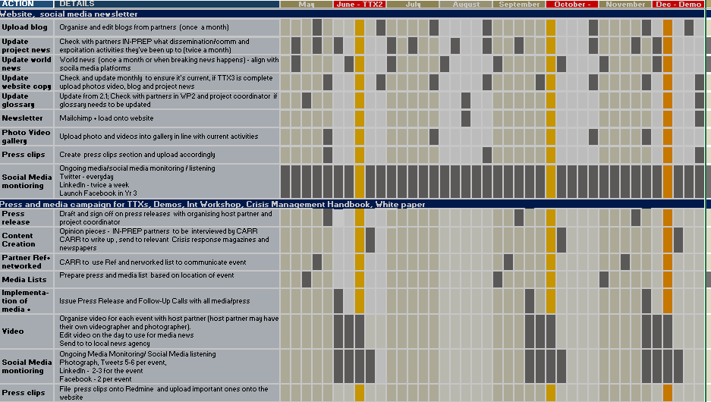
Critical path – Comms programme
https://redmine.iccs.gr/projects/in-prep/dmsf?folder_id=6738

Slide 12
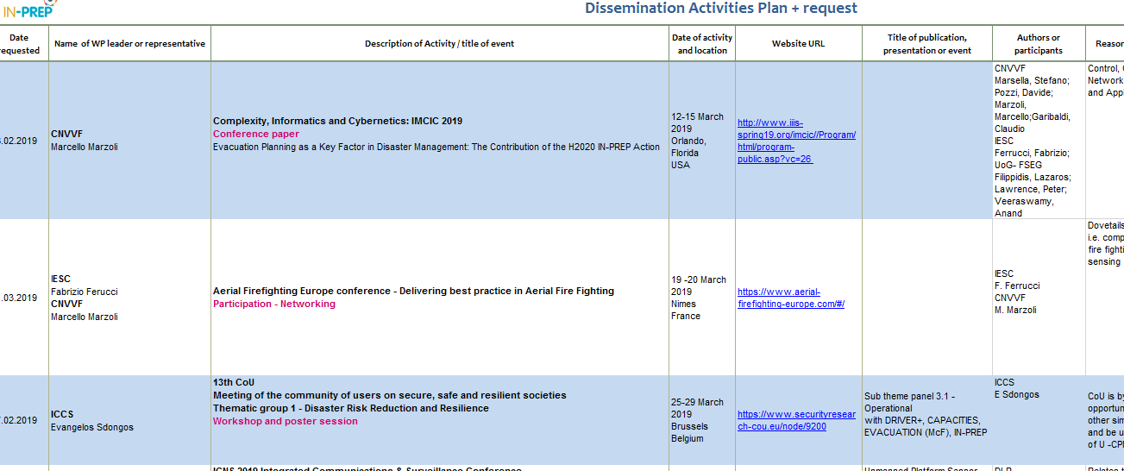
Partner outreach – dissemination list / plan
https://redmine.iccs.gr/projects/in-prep/dmsf?folder_id=4409

Slide 13
For more information contact
Meadhbh Costello
Karl Coleman
CARR Communications
meadhbh@carrcommunications.ie
karl@carrcommunications.ie
+353 1 7728900

