Slide 1
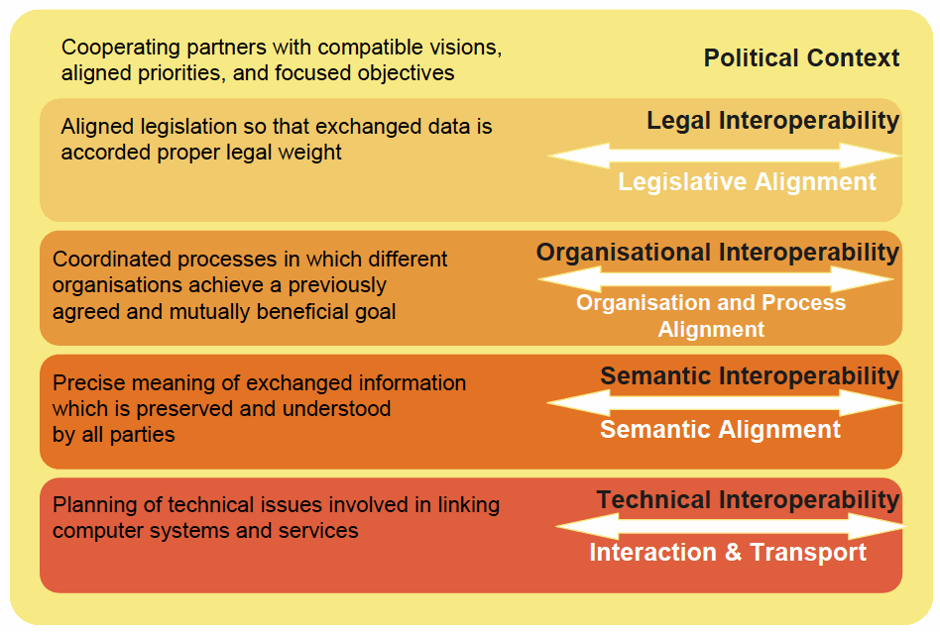
Interoperability
Harmonised Strategy/Doctrines
Aligned Operations
Organizational
Interoperability
Aligned Procedures
Knowledge/Awareness
Information Interoperability
Technical
Interoperability
Data Object/Model Interoperability
Protocol Interoperability
Physical Interoperability

